Slide 1
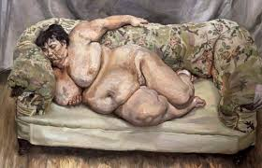
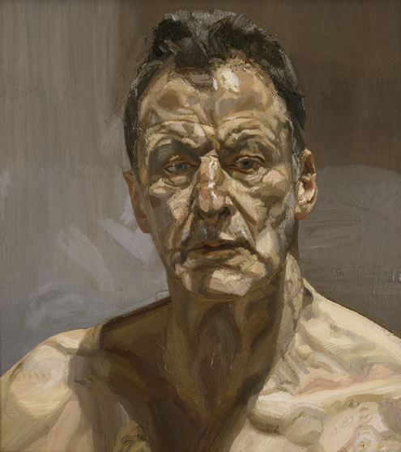
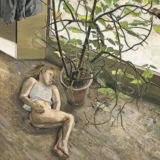
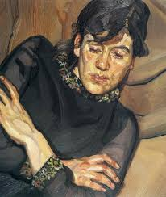

Slide 2
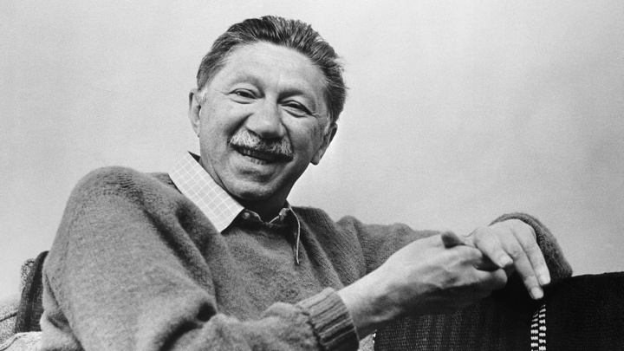
‘’If all you have is a hammer, everything looks like a nail’’
Abraham Maslow

Slide 3
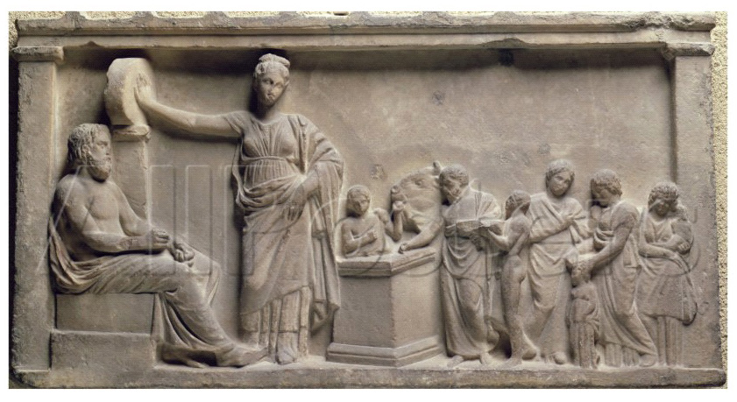
Hippocrates
Galen
Aretaeus of Cappadocia
Humoral Theory

Slide 4
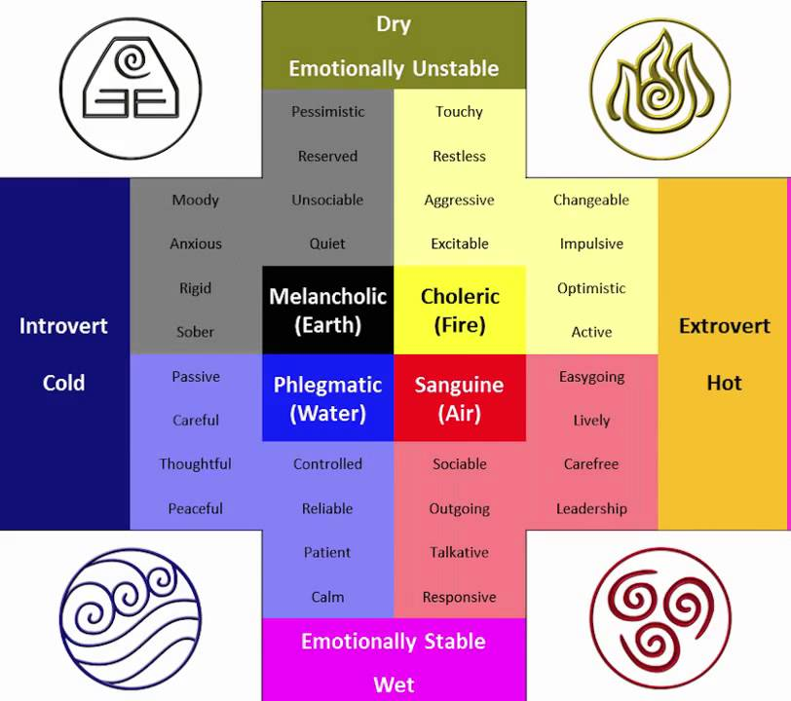

Slide 5
The Anatomy of Melancholy, What it is: With all the Kinds, Causes, Symptomes, Prognostickes, and Several Cures of it. In Three Maine Partitions with their several Sections, Members, and Subsections. Philosophically, Medicinally, Historically, Opened and Cut Up) is a book by Robert Burton, first published in 1621

Slide 6
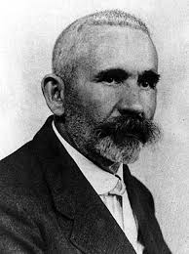
Distinction between endogenous (internally caused) and exogenous (externally caused) types
Emil Kraepelin

Slide 7
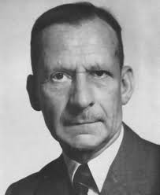
Coined the terms endogenous depression and reactive depression in 1920
Kurt Schneider

Slide 8
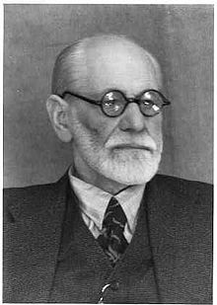
-
1917 Mourning and Melancholia
The objective loss, such as the loss of a valued relationship through death or a romantic break-up, results in subjective loss as well; ( the libido withdraws into the ego and identifies itself with the lost object.)

Slide 9
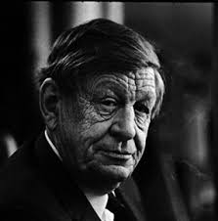
Funeral Blues
Stop all the clocks, cut off the telephone, Prevent the dog from barking with a juicy bone, Silence the pianos and with muffled drum Bring out the coffin, let the mourners come. Let aeroplanes circle moaning overhead Scribbling on the sky the message 'He is Dead'. Put crepe bows round the white necks of the public doves, Let the traffic policemen wear black cotton gloves. He was my North, my South, my East and West, My working week and my Sunday rest, My noon, my midnight, my talk, my song; I thought that love would last forever: I was wrong. The stars are not wanted now; put out every one, Pack up the moon and dismantle the sun, Pour away the ocean and sweep up the wood; For nothing now can ever come to any good.
Wystan Hugh Auden

Slide 10
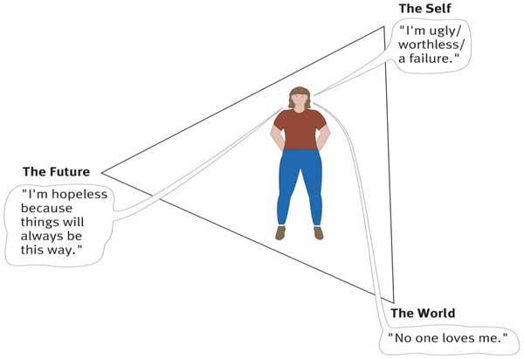
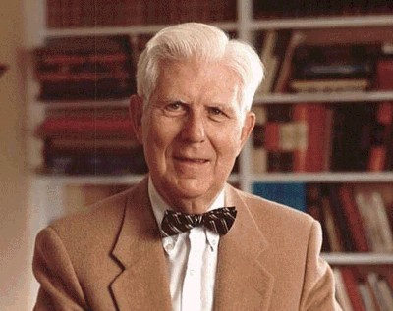
Aaron Temkin Beck

Slide 11
Veraguth's fold
Non-verbal communication in depression

Slide 12
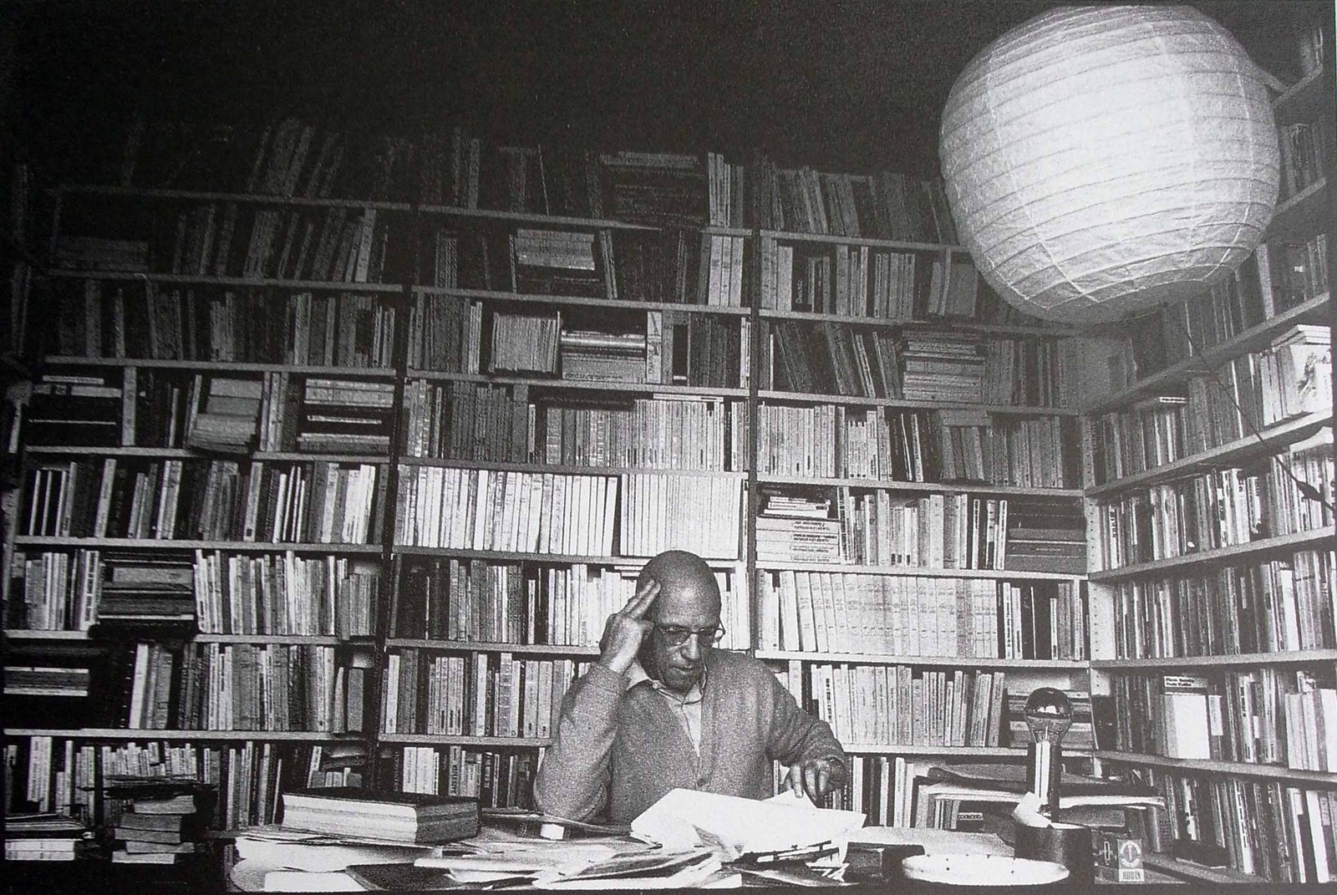

Slide 13
In his early 20s were subject to erratic behaviour, depression, and even suicide attempts. As he sought treatment for his troubled thoughts, Foucault became even more fascinated with psychology and psychopathology, and he pursued formal training in both fields by the time he turned 26 in 1952.

Slide 14
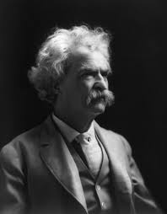
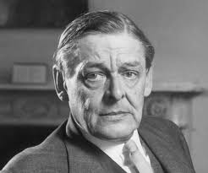
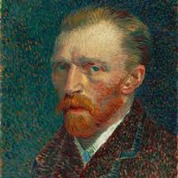
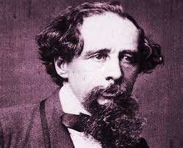

Slide 15
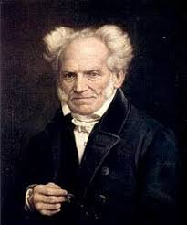
The vanity of existence is revealed in the whole form existence assumes: in the infiniteness of time and space contrasted with the finiteness of the individual in both; in the fleeting present as the sole form in which actuality exists; in the contingency and relativity of all things; in continual becoming without being; in continual desire without satisfaction; in the continual frustration of striving of which life consists."

Slide 18
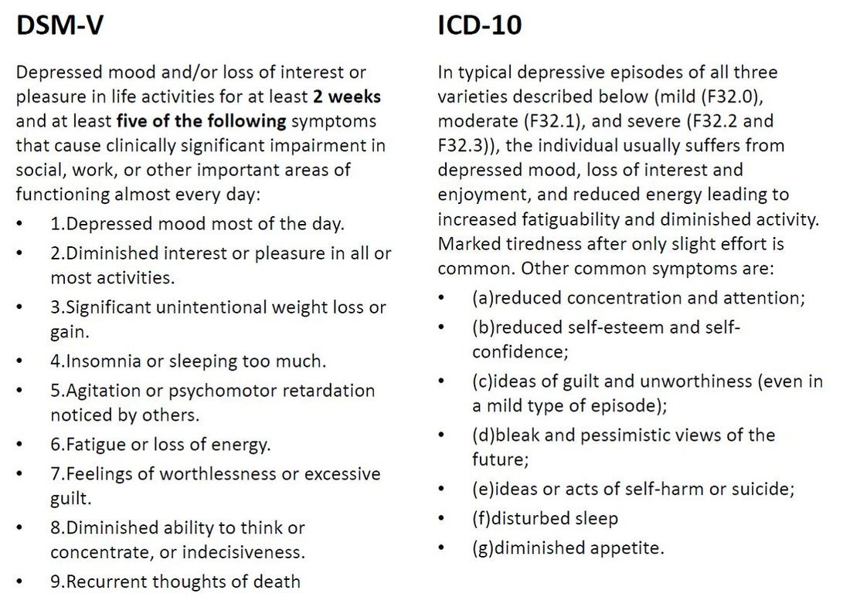

Slide 19
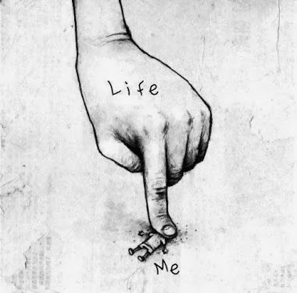
Mood
Depressed, sad, hopeless, discouraged, or "down in the dumps“
Feeling "blah," having no feelings, or feeling anxious. The presence of a depressed mood can be inferred from the person's facial expression and demeanor.
Some individuals emphasize Somatic complaints (e.g., bodily aches and pains)
Increased irritability (e.g., persistent anger, a tendency to respond to events with angry outbursts or blaming others, an exaggerated sense of frustration over minor matters)

Slide 20
Loss of interest or pleasure
Less interested in hobbies
“Not caring anymore“
Not feeling any enjoyment in activities that were previously considered pleasurable
Social withdrawal or neglect of pleasurable avocations

Slide 21
Appetite
Either a reduction or increase
They have to force themselves to eat
May crave specific foods (e.g., sweets or other carbohydrates)

Slide 22
Sleep disturbance
Either difficulty sleeping or sleeping excessively
Middle insomnia (i.e., waking up during the night and then having difficulty returning to sleep)
Terminal insomnia (i.e., waking too early and being unable to return to sleep)

Slide 23
Psychomotor changes
Agitation (e.g., the inability to sit still, pacing, handwringing; or pulling or rubbing of the skin, clothing, or other objects)
Retardation (e.g., slowed speech, thinking, and body movements; increased pauses before answering; speech that is decreased in volume, inflection, amount, or variety of content, or muteness)

Slide 24
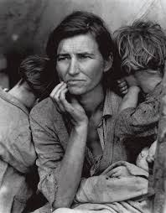
Decreased energy, tiredness, and fatigue
Fatigue without physical exertion
Reduced efficiency

Slide 25
sense of worthlessness or guilt
Unrealistic negative evaluations of one's worth or guilty
Often misinterpret neutral or trivial day-to-day events as evidence of personal defects and have an exaggerated sense of responsibility for untoward events
The sense of worthlessness or guilt may be of delusional proportions (e.g., an individual who is convinced that he or she is personally responsible for world poverty

Slide 26
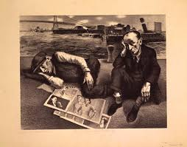
impaired ability to think, concentrate, or make even minor decisions
Easily distracted
Memory difficulties

Slide 27
Thoughts of death, suicidal ideation, or suicide attempts
Passive wish not to awaken in the morning
Belief that others would be better off if the individual were dead
Recurrent thoughts of committing suicide
Specific suicide plan
More severely suicidal individuals may have put their affairs in order (e.g., updated wills, settled debts), acquired needed materials (e.g., a rope or a gun), and chosen a location and time to accomplish the suicide

Slide 28
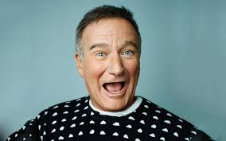

Slide 30
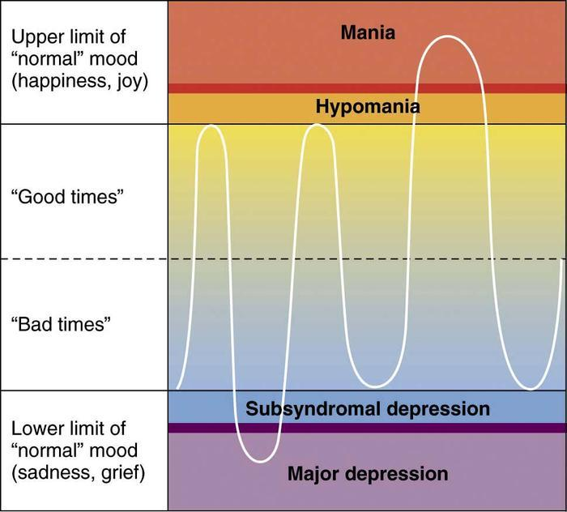

Slide 31
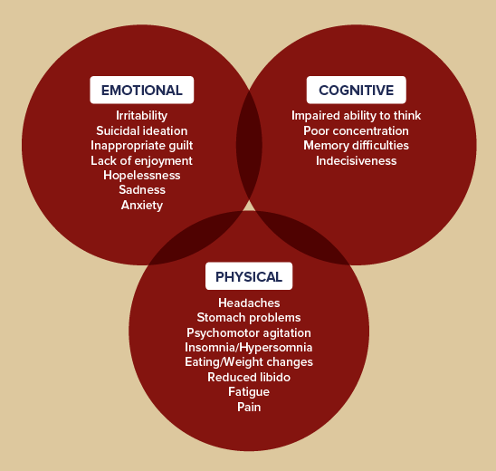

Slide 34
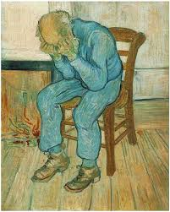

Slide 36
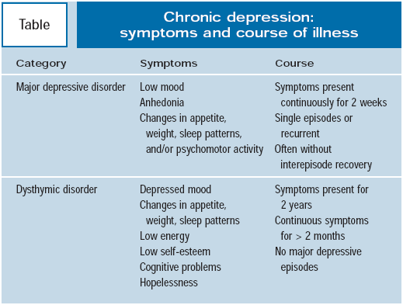

Slide 43
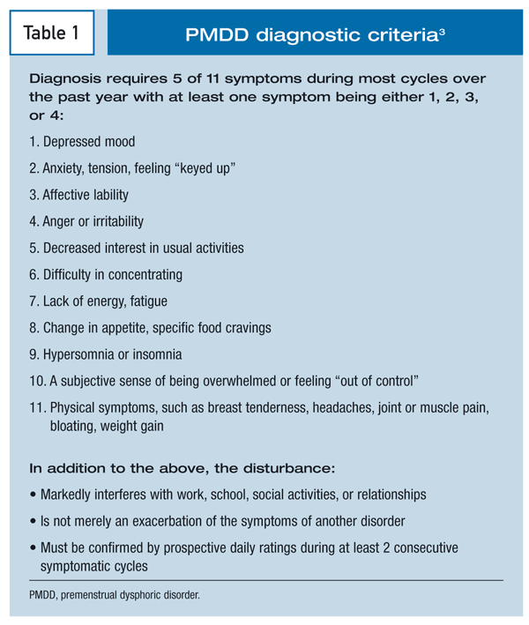

Slide 44
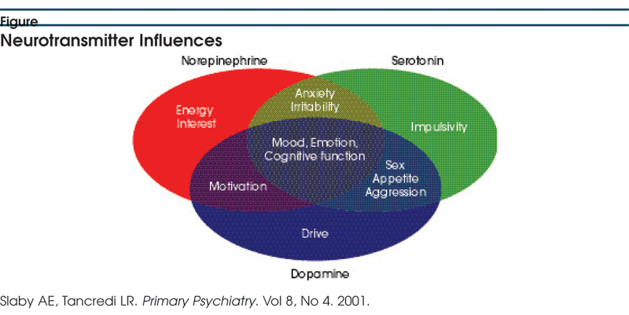

Slide 45
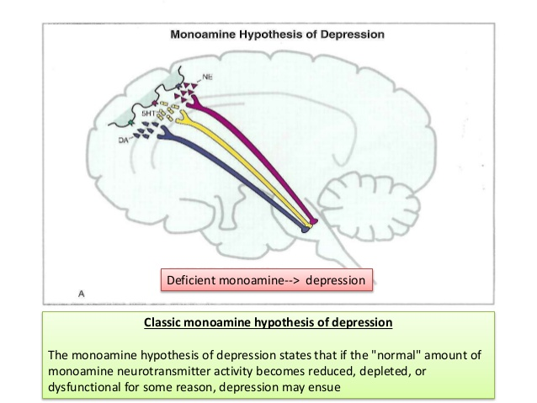

Slide 46
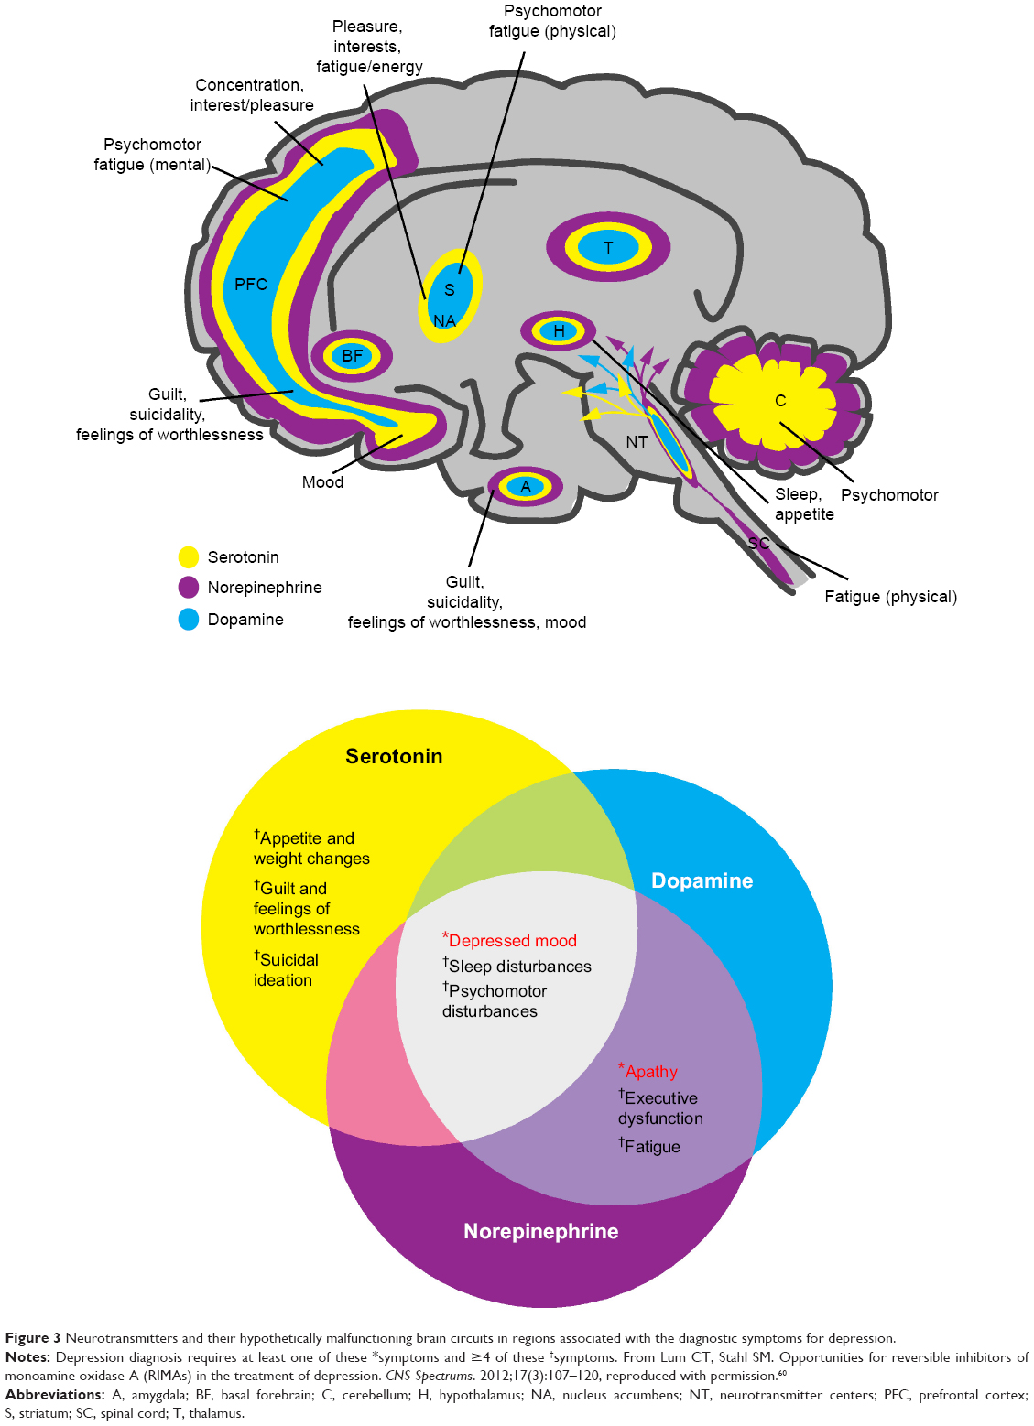

Slide 48
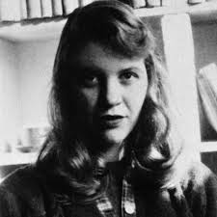
“If you expect nothing from somebody you are never disappointed.”

Slide 49
In his 1990 memoir, William Styron, the author of Sophie's Choice, turns his storytelling gift to his own battle with depression. Darkness Visible opens in Paris, where Styron has come to accept a literary prize but instead has a breakdown. He undergoes therapy, takes prescription drugs (some of which he cautions against), has suicidal thoughts, and is hospitalized

Slide 50
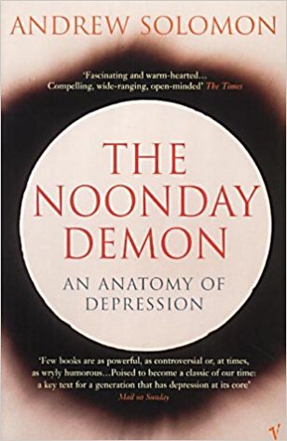
Winner of the 2001 National Book Award, The Noonday Demon is far more than a memoir. It is also a comprehensive survey of the history of depression, its cultural implications, and the many treatments that have been used to combat it.

Slide 51
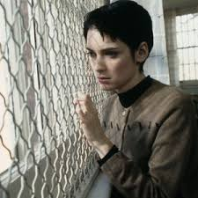
In 1967, 18-year-old Susanna Kaysen took 50 aspirin tablets, saw a psychiatrist once, was immediately ushered into a taxicab, and sent to McClean Hospital in Boston, where she was treated for depression for 18 months.

