Slide 1
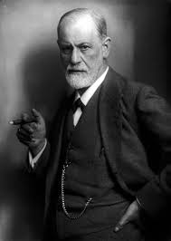
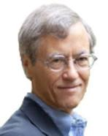
Αnxiety Disorders
The adaptive unconcious

Slide 3
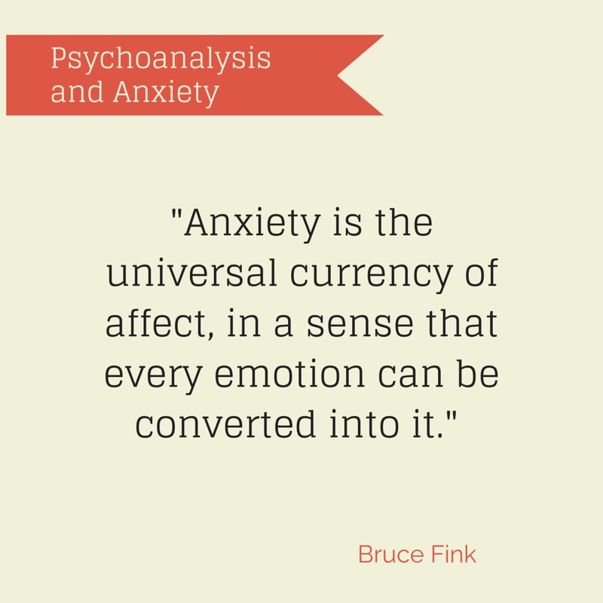
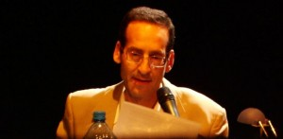

Slide 4
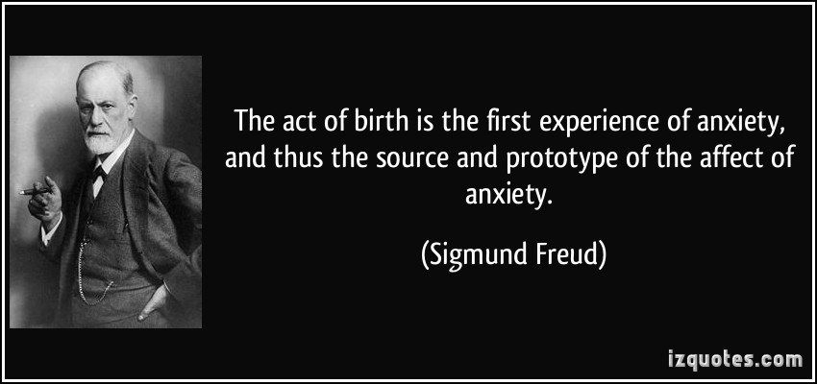

Slide 6
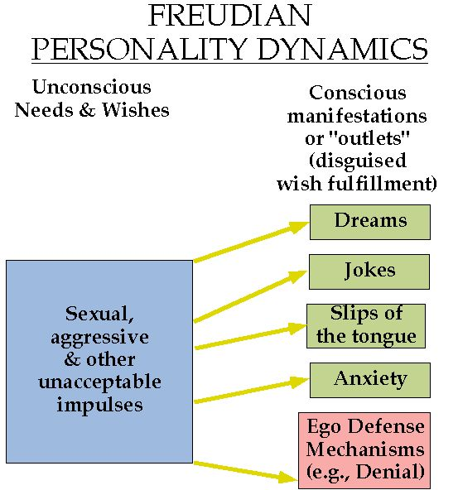

Slide 7
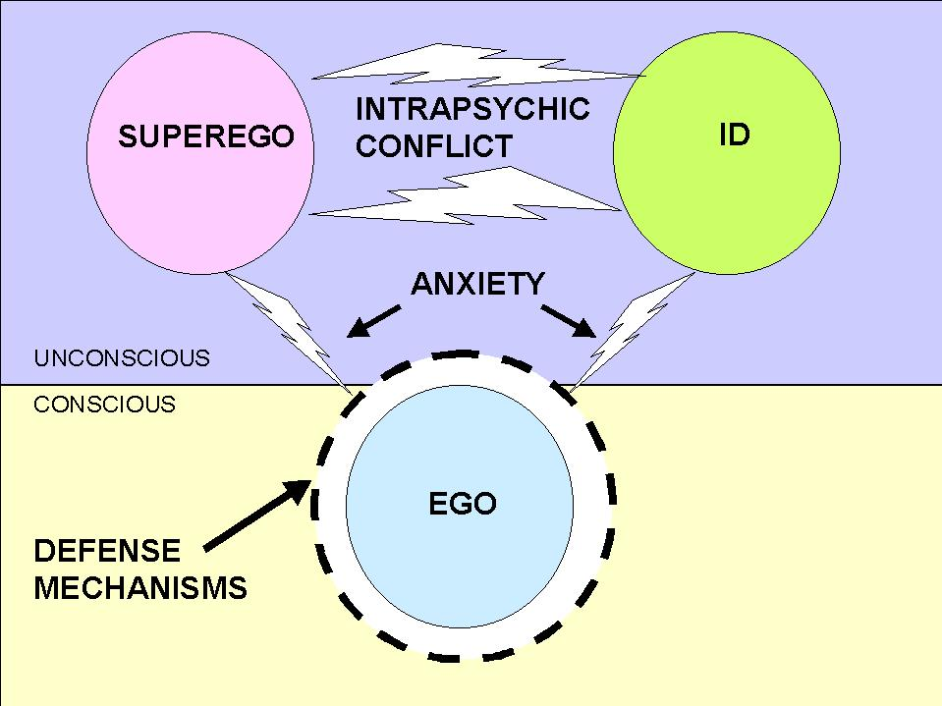

Slide 8
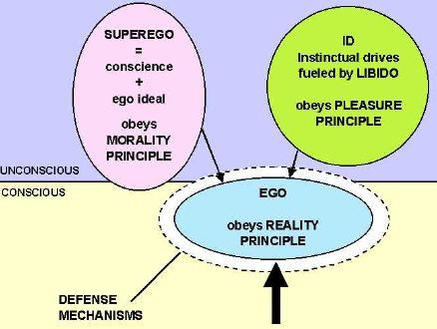

Slide 9
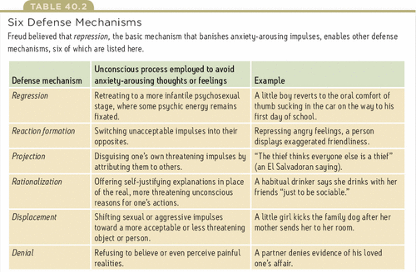
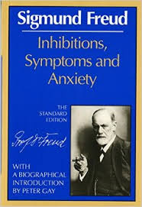

Slide 13
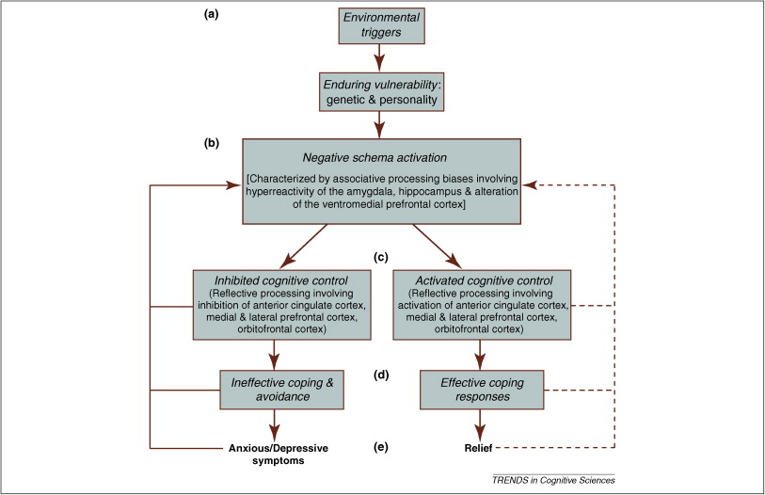

Slide 14
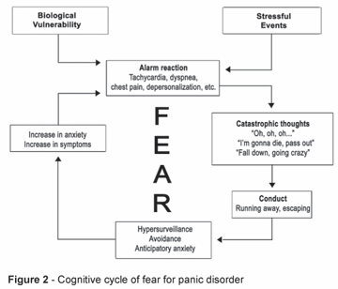
Cognitive model of panic disorder

Slide 17
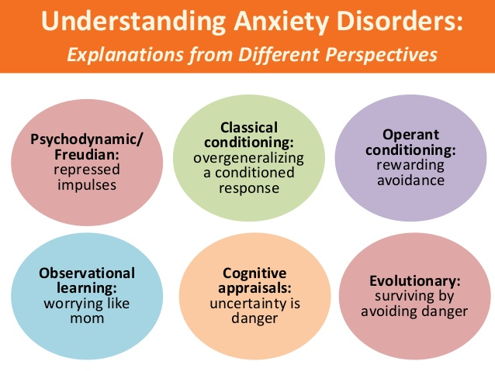

Slide 18
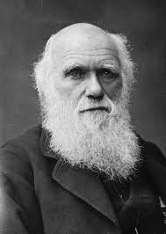
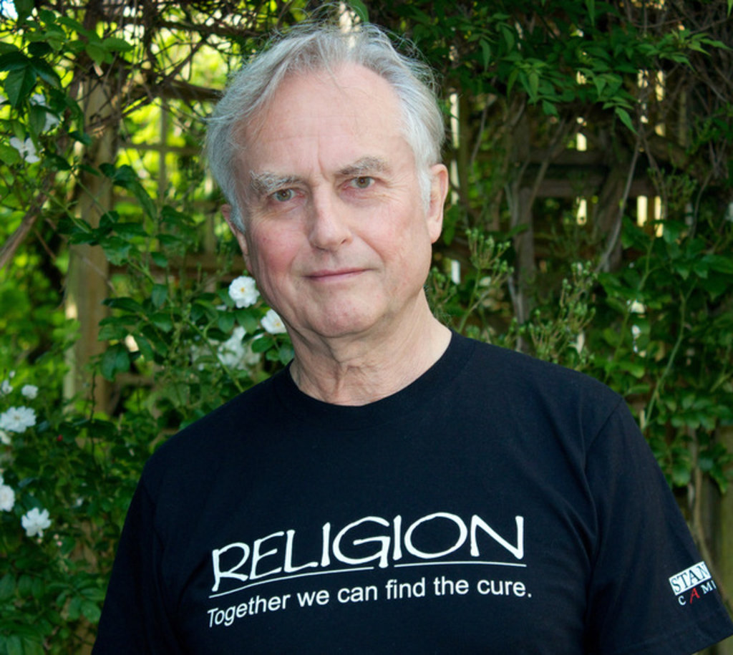
Evolutionary synthesis

Slide 19
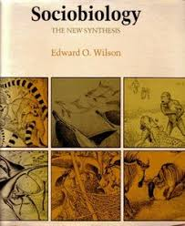
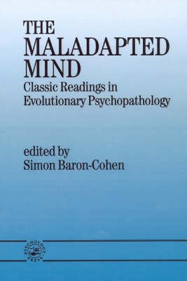
Cultural anthropology debunked

Slide 20
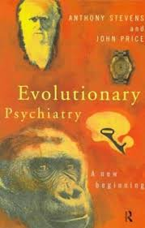
Modern times are not like the times in which our ancestors evolved. The environment of evolutionary adaptation (EEA) usually refers to the habitat of our immediate ancestors who are thought, to have been hunter-gatherers living in bands of about 50 adults

Slide 21
The “mismatch” between now and the EEA is thought to be one cause of psychopathology
“Bad news” is a source of anxiety. We now have daily, or even hourly, access to the bad news of six billion people, more than could be generated by a hunter-gatherer band
Moreover, in the EEA, bad news was probably discussed and so shared with other group members, whereas modern man tends to watch it, or listen to it on his own, or at least without comment

Slide 22
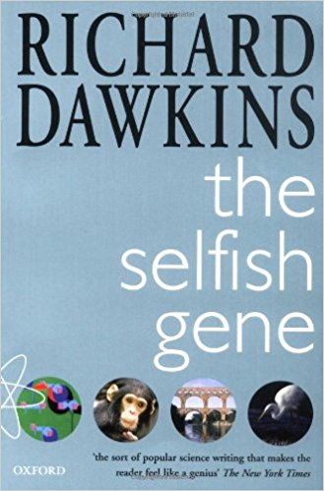
An evolutionary approach to any behaviour (including anxiety and other forms of psychopathology) refers to two separate “causes”. One is the question of function. What is the function of this behaviour, if any? Why has it evolved? What adaptive advantage does it give to the individual, or the individual’s close kin, or to the individual’s social group? This approach relies on behavioural ecology, which is the study of the function of behaviour, and the evolution of alternative behavioural strategies

Slide 23
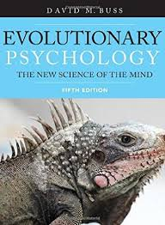
The other question is its phylogenetic origin. How did it evolve in our ancestors, and does it occur in other species? Clearly the fossil record does not record anxiety, and whether it occurs in our immediate-return hunter-gatherer ancestors has not been adequately studied. So the occurrence of anxiety in other species is of interest, bearing in mind that behaviour can be very different in closely related species, such as the absence or presence of paternal behaviour in some rodents

Slide 24
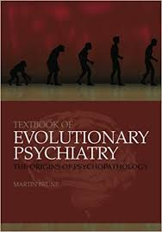
Behavioral observation of patients with anxiety disorders suggests that these disorders – as a group – reflect exaggerated responses to internal or external signals of perceived danger or threat. The autonomic part of the anxiety response pattern prepares the organism for one of several response options to terminate the anxiety-eliciting situation, namely, flight, immobility, submission or aggression

Slide 25
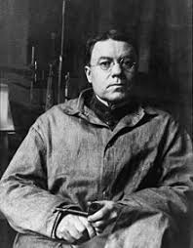
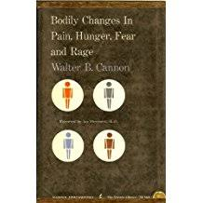
Anxiety is a form of vigilance which enables an organism to be alert to environmental changes so that it can be prepared to meet whatever emergencies may arise
WB Cannon (1929) linked this state to the neurophysiological state of arousal, which was mobilized by hypothalamic structures in the limbic system

Slide 26
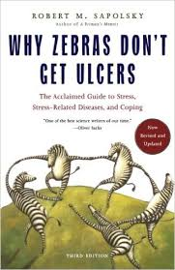
Arousal prepares the body for violent action
Heart rate increases
Blood pressure goes up
Adrenaline is secreted
Energy stores are mobilized in the liver
Blood is redistributed from internal organs to the muscles and the brain
Thyroid gland is stimulated (increase metabolism)

Slide 27
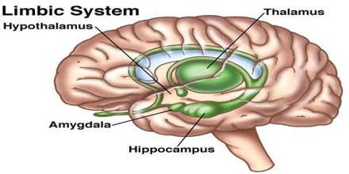

Slide 28
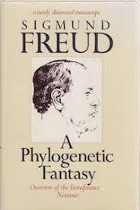
A phylogenetic fantasy
Freud suggested that certain states of mind, such as paranoia and anxiety, were remnants of responses which were biologically adaptive in human beings up to the time of ice age

Slide 29
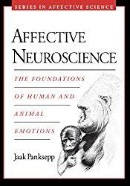
The neurophysiological components of anxiety, fear and panic are broadly similar
Caused by snakes, spiders, darkness, or social scrutiny
They constitute a general systemic response to a wide variety of potentially dangerous situations
Anxiety disorders are thus to be understood as exaggerated or inappropriate forms of adaptive strategies

Slide 30
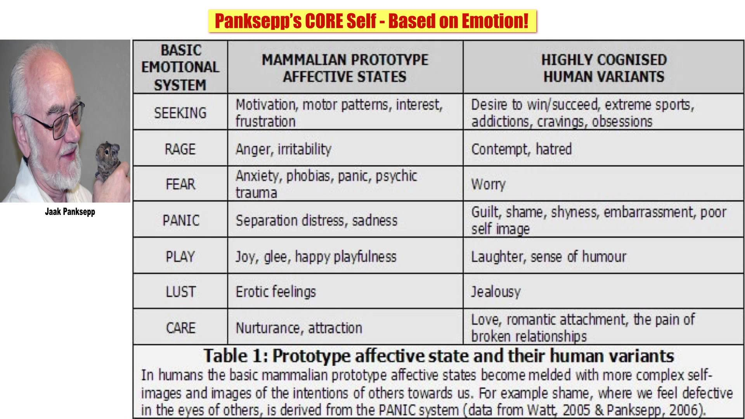

Slide 31
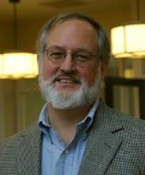
Nesse
Instructive parallel between anxiety/immune system
Both general and specific defence mechanisms
General : pain, fever, inflammation, lymphocyte mobilation
Specific: immunoglobulins (invasion of bacteria), interferon (virus), eosinophils (parasites), natural killer calls (cancer)

Slide 32
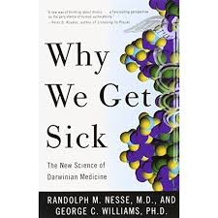
General anxiety: fight of flight
Special
Acrophobia promotes freezing (rendering one less likely to fall)
Haemophobia promotes fainting (bradycardia, rapid drope in blood pressure----rendering one less likely to bleed to death)
Agoraphobia causes one to stay at home (rnd less likely to get mugged /raped)

Slide 33
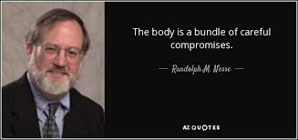
Anxiety which promotes avoidance of escape ----remove from a source of threat (disgust, vomitting, diarrhoea, coughing, sneezing)
Anxiety which promotes aggresive defence -----attack the source of danger

Slide 34
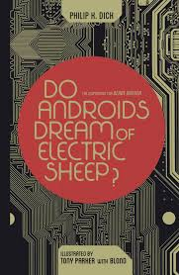
The anxiety is a necessary preliminary and it helps to energize the subsequent behavior
The behavior is not an automatic subroutine-----an element of choice (?) occurs at some level of appraisal

Slide 35
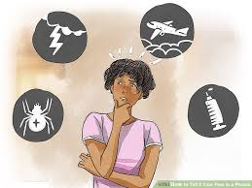
The adaptive function of anxiety
Anxiety and fear are adaptive responses to the kind of dangers humans have been exposed in the course of their evolution
We fear ancient dangers such as snakes, spiders, high/open places

Slide 36
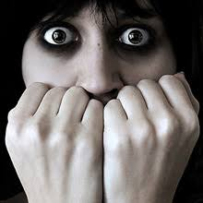
We don’t fear cars, guns, cigarrettes and whiskey, saturated fats
Modern phobias (going to school, to the dentist contracting AIDS) are contemporary versions of adaptive fears (going off the home range, getting hurt, getting infected)

Slide 38
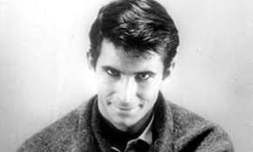
Our universal fear which is manifested throughout the world community in infants, starting at about six month of age, is fear of strangers (xenophobia)

Slide 39
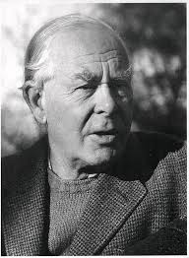
This begins as shyness or slight wariness of unfamiliar people, and by twelve months it has become a very evident fear
Young children delight in crawling off in exploratory forays away from their mother, using her as a ''secure base''

Slide 40
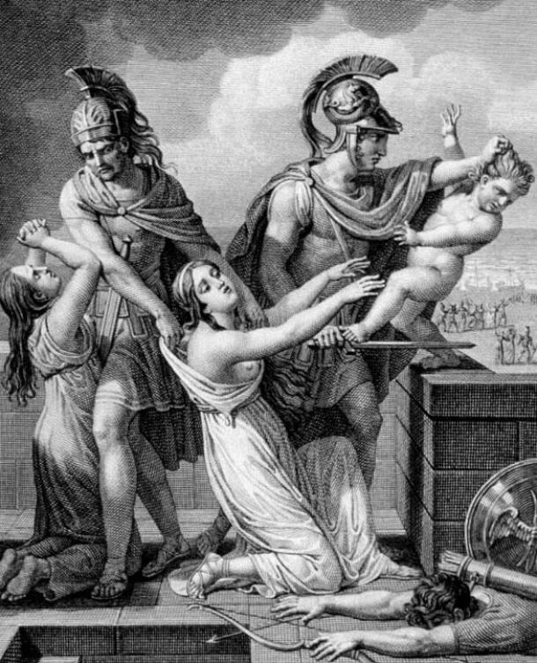
Adaptiveness of infant xenophobia
Infanticide by strangers is common among primate species
Strong selective force
Human infants are more likely to be abused/killed by non kin

Slide 41
Depression is thought to be related to social factors in relation to other human beings, whereas anxiety is related partly to social situations but also to non-social dangers.
The strategies for dealing with human danger include submission, whereas this is not an appropriate response to non-human danger.
Anxiety is classically thought to be concerned with the threat of danger, whereas depression is thought to be the result of danger

Slide 42
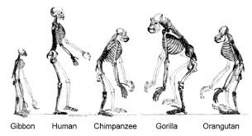
Human competition is very different from animal competition, and most of the methods of competition do not involve face-to-face encounters with rivals. Moreover, success is achieved not by intimidating a rival, but by attracting positive responses from other members of the group, resulting in prestige.

Slide 43
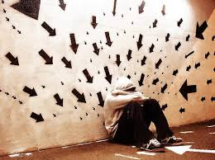
SOCIAL ANXIETY DISORDER (SAD)
Social anxiety disorder (SAD) is an exaggeration of the normal submissive or appeasement display which people make to more powerful individuals or to a disapproving group
SAD is an excessive fear of humiliating or embarrassing oneself while being exposed to public scrutiny or to unfamiliar people, resulting in intense anxiety upon exposure to social performance situations

Slide 44
Feared social situations are either avoided as much as possible or create significant distress. Physical manifestations of anxiety in the feared situations include a shaky voice, clammy hands, tremors and blushing
From an evolutionary point of view, SAD must promote group functioning by reducing social competition, and ensuring that group discussions in the council chamber do not last indefinitely

Slide 45
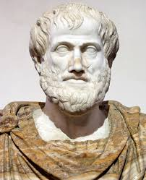
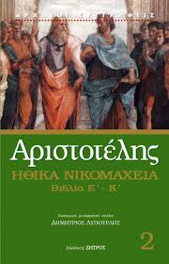
Aristotle pointed out that if someone hits you, you experience pain; if the pain is caused by a higher ranking individual, you feel sad, if it is caused by a lower-ranking individual, you feel angry. You have no choice about these reactions as they are determined by the sub-rational brain
You do have a choice about your voluntary action. You can attack the person who hit you, and this is the fight version of the fight/flight response; or you can shrink away, and this is the flight version of the fight/flight response

Slide 47
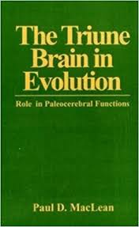
Danger and harm are avoided by strategic decisions made at all three levels of the triune forebrain: rational (neomammalian), emotional (paleomammalian), and instinctive (reptilian). This applies also to potential harm from conspecifics, which leads to a choice between escalating and de-escalating strategies. Anxiety is a component of de-escalating strategies mediated by the paleomammalian and reptilian forebrains. When the neomammalian (rational) brain fails to deal with the threat of conspecific danger, these more primitive de-escalating strategies may be activated and may present as anxiety disorders

Slide 48
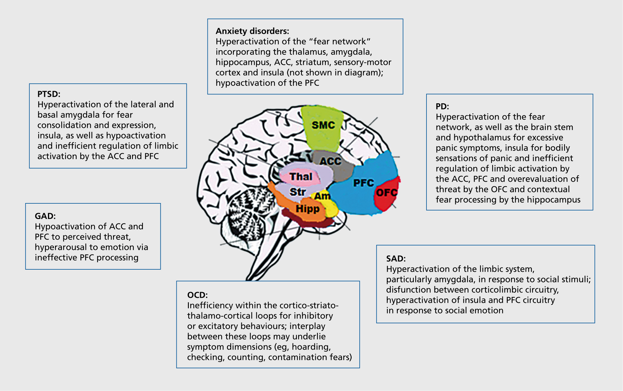

Slide 57
Specific Phobia

Slide 62
Eυχαριστώ

