Slide 1
Διπολική Διαταραχή

Slide 2
Also known as manic depression, a mental illness that causes a person’s moods to swing from extremely happy to energized (mania) to extremely sad (depression)
Most often diagnosed in adolescence

Slide 3
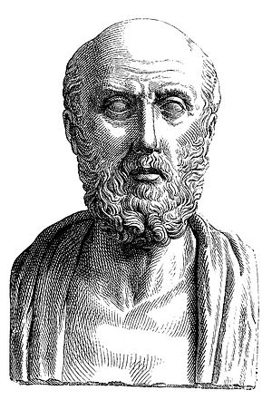
Black bile (μελαγχολία)
Yellow bile (μανία)

Slide 4

Ομήρου Ιλιάδα

Slide 5
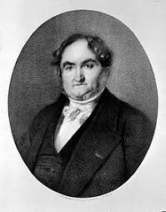
Jean-Pierre Falret
1851 la folie circulaire (circular insanity)

Slide 6
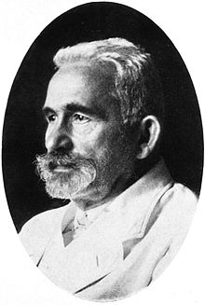
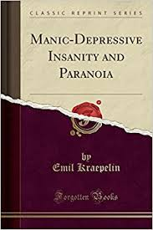
Kraepelinian dichotomy

Slide 7
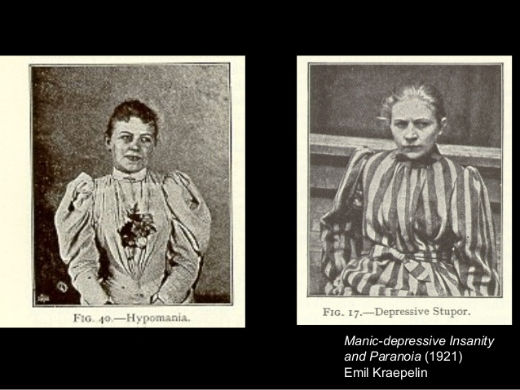

Slide 8
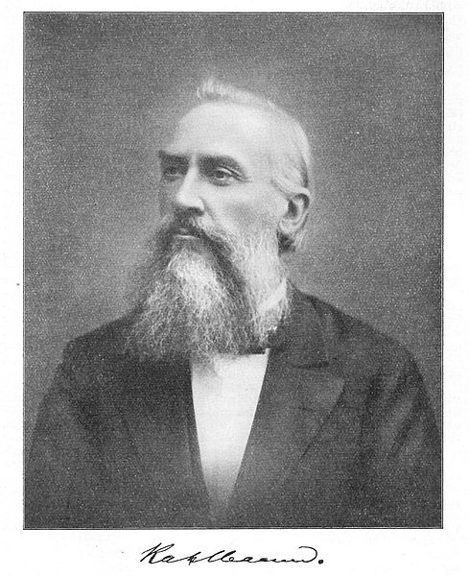

Karl Ludwig Kahlbaum (1828 –1899)
Classification of psychosis by symptom, course and outcome

Slide 9

(1903) Distinction between manic-depression involving psychotic states, and that which does not involve psychosis

Slide 10

DSM-5 as that between 'bipolar I' (mania involving possible psychotic episodes) and 'bipolar II' (hypomania without psychosis)

Slide 11
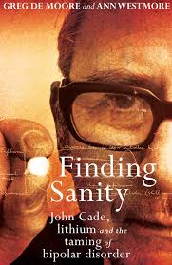
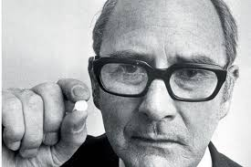
Lithium (1949)

Slide 12
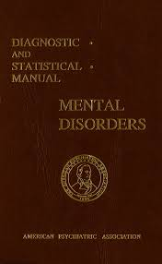
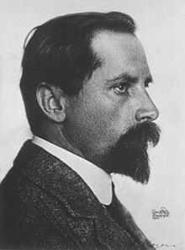
Manic depression reaction (1952)

Slide 13
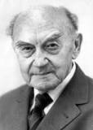

Karl Leonardt ''Bipolar'' – ''Unipolar'' (1957)

Slide 14
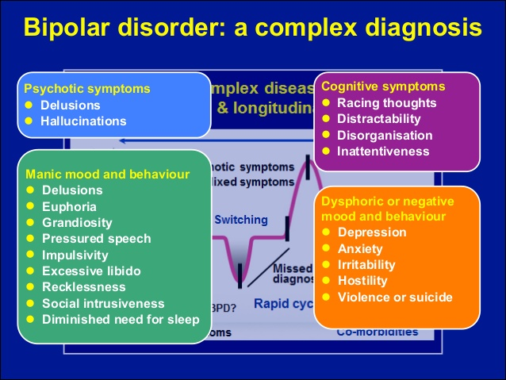

Slide 15
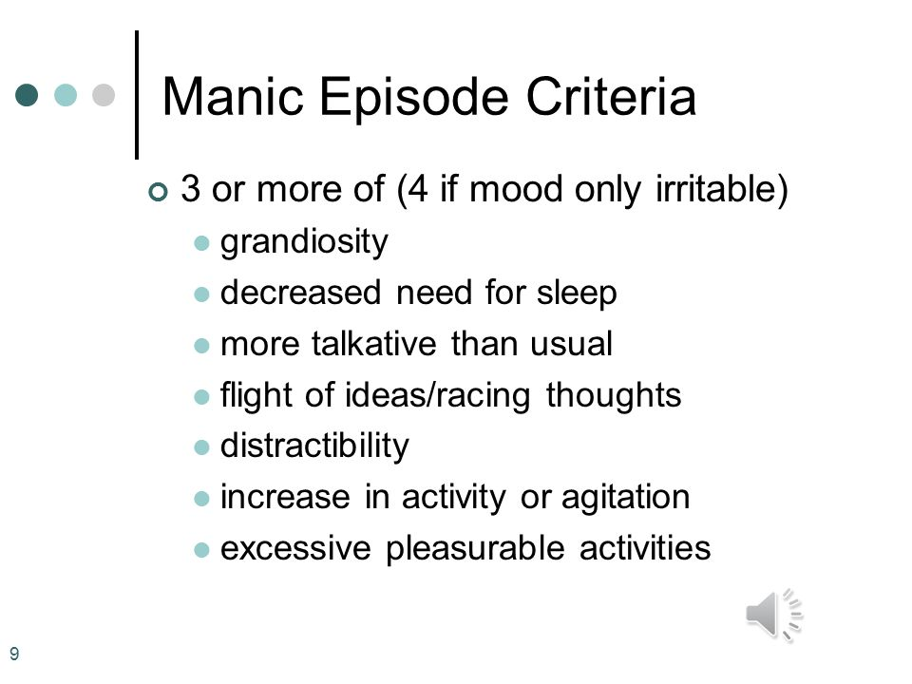

Slide 16
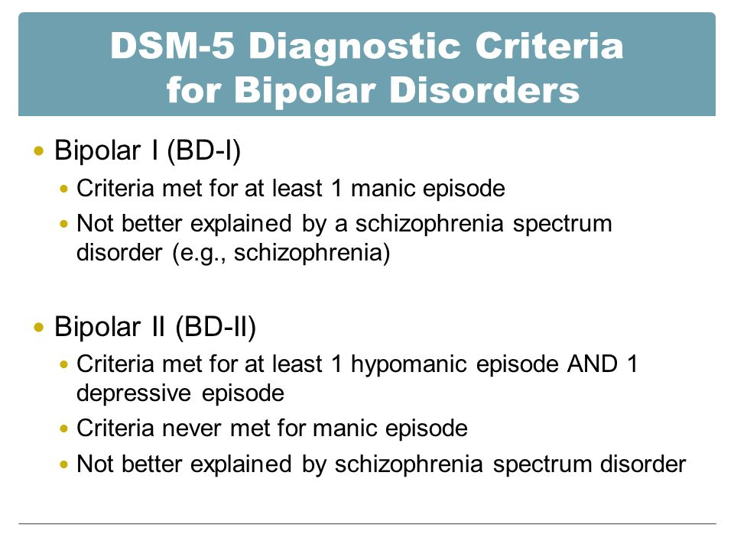

Slide 17
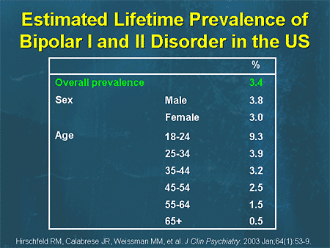

Slide 18
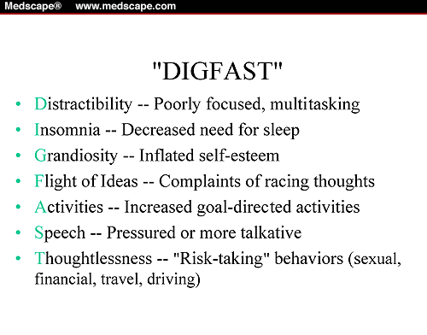

Slide 19
Mood
Euphoric,cheerful, high, ‘’top of the world’’
Unlimited enthousiasm for interpersonal, sexual, or occupational interactions
Irritable when the individual’s wishes are denied

Slide 20
Increased activity
Multiple overlapping projects
Little knowledge of the topic
Nothing out of reach
Increased activity at unusual hours

Slide 21
Inflated self-esteem
Uncritical self-confidence to marked grandiosity
Complex tasks (writing a novel, seeking publicity for some impractical invention)
Grandiose delusions (of having a relationship to a famous person)

Slide 22
Sleep
Decreased need for sleep
Distinct from insomnia (the individual wants to sleep but is unable)
Severe mania----days without sleep (yet not feel tired)

Slide 23
Speech
Rapid, pressured, loud, difficult to interrupt
Talking continuously and without regard for others’ wishes to communicate
Jokes, puns, amusing irrelevancies, theatricality, dramatic mannierisms, singing, excessive gesturing
Hostility, complaints, angry tirades (irritable mood)

Slide 24
Thought process
Fast race rate (cannot be expressed through speech)
Flight of ideas
Accelerated speech, abrupt shifts from one topic to another
Severe----disorganized, incoherent

Slide 25
Distractibility
Inability to censor external stimuli (background noises or conversations, furnishings in the room)

Slide 26
Increase in goal directed activity
Multiple activities (sexual, occupational, political, religious)
Increased sociablility (without regard to the intrusiveor demanding nature of these interactions)
Psychomotor agitation/restlessness (purposeless activity)
Excessive letters, emails, and so forth to friends, public figures or the media

Slide 27
Involvement in high risk activities
Spending sprees
Giving away possessions
Reckless driving
Foolish business investments
Sexual promiscuity (that is unusual for the individual)

Slide 28
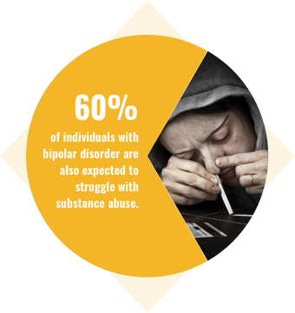

Slide 29
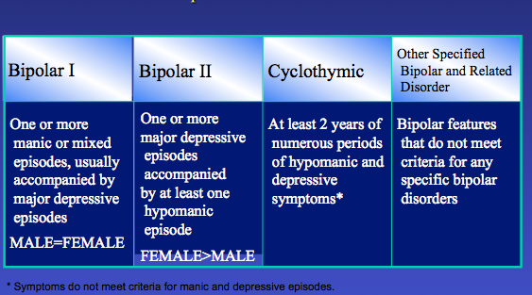

Slide 30
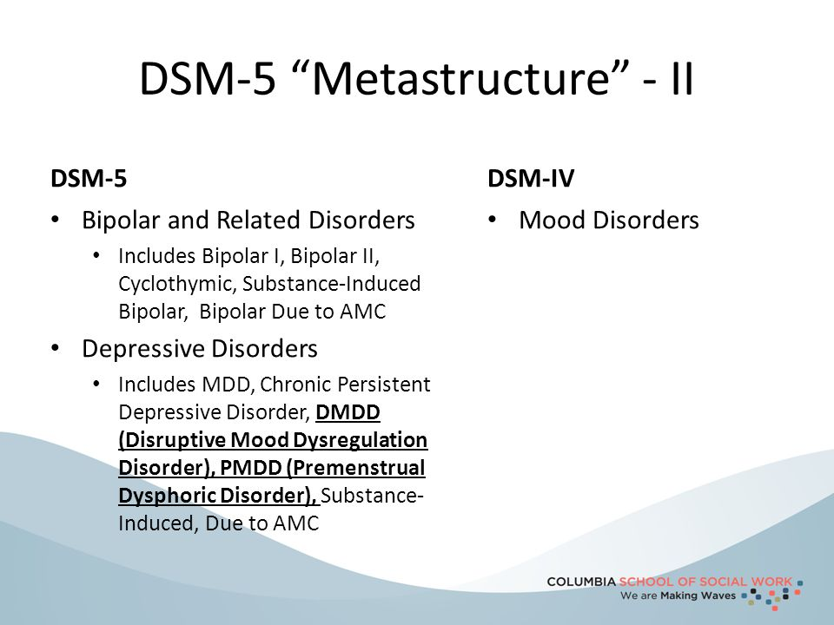

Slide 31
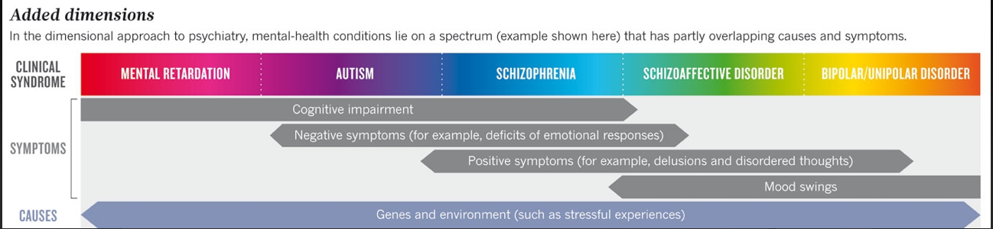

Slide 32
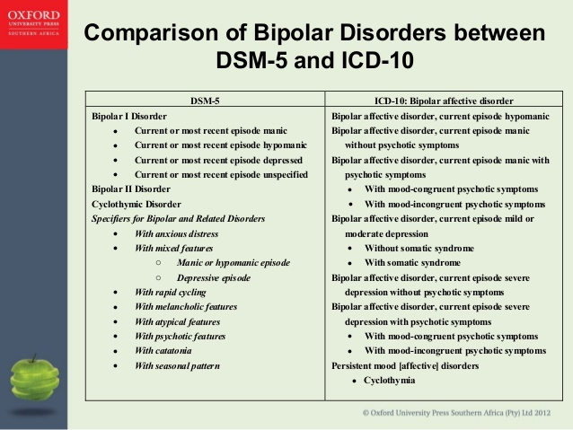

Slide 33
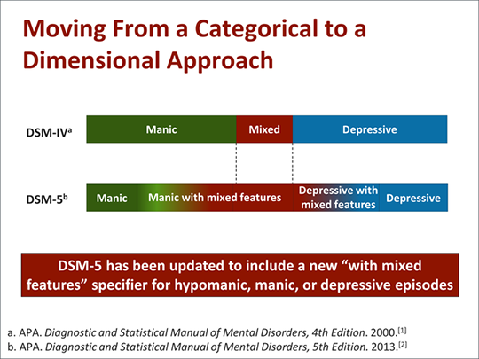

Slide 34
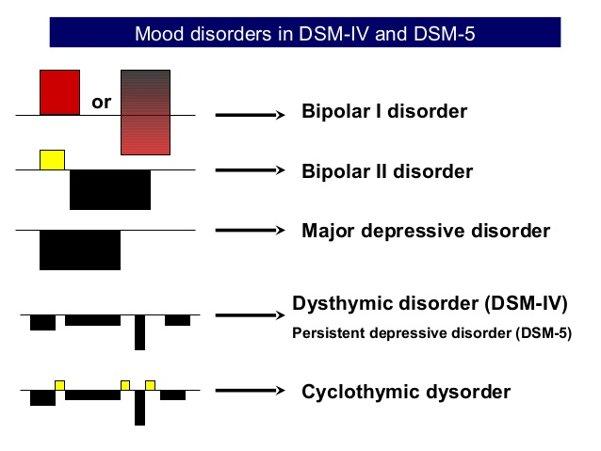

Slide 35
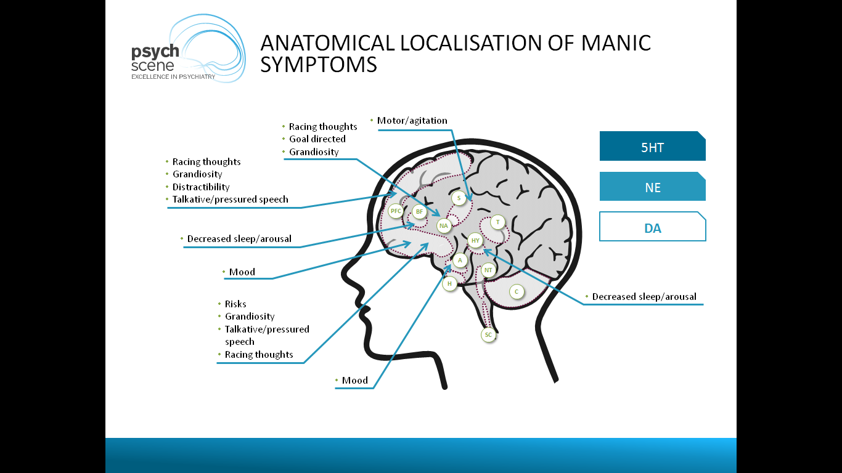

Slide 36
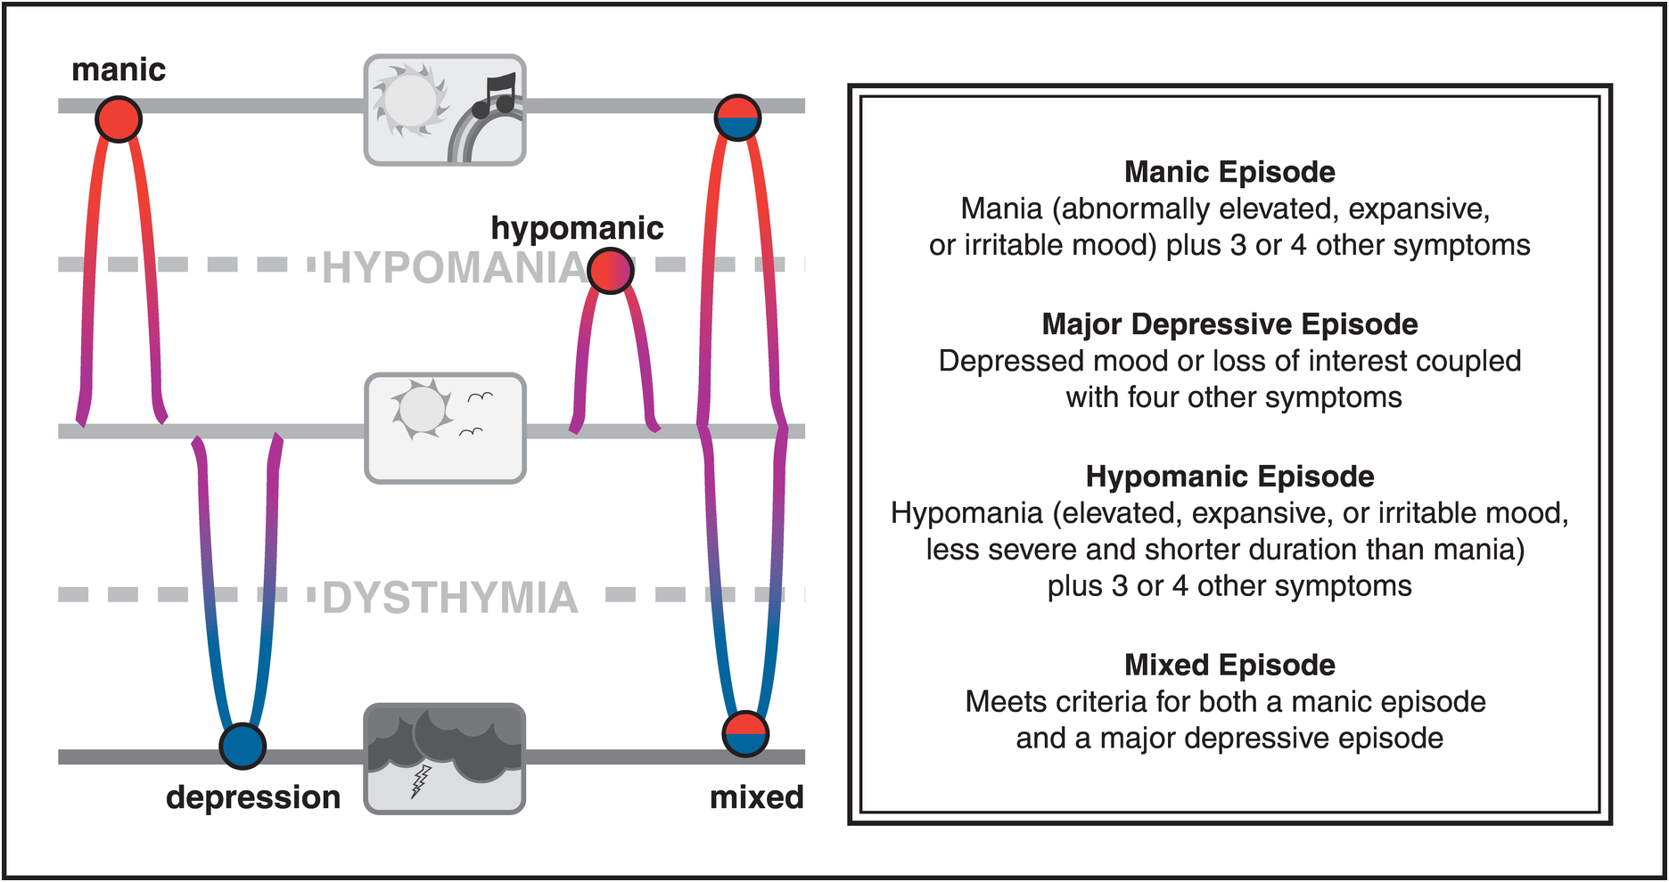

Slide 37
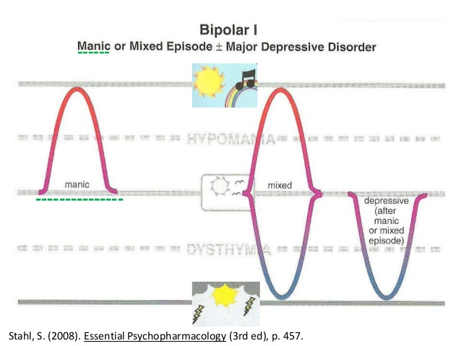

Slide 38
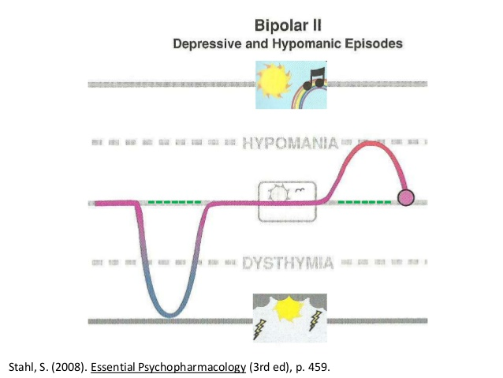

Slide 39
